Slide 1
Medicare Advantage Plans
Overview
Broker Training
10182021

Slide 2
Module Description
This module is designed to explain:
History of Medicare
Medicare “ABCDs”
Medicare Enrollment Periods
Plans and Service Area
Medicare Products
Sales Office Locations

Slide 3
History of Medicare
Medicare is a federally sponsored health insurance program for seniors and the disabled.
Medicare was first created in 1965 and is designed to provide medical coverage to people on Social Security.
Medicare is commonly confused with Medicaid. Medicaid was created for those in poverty.
Medicare is funded through individuals contributing to a payroll tax throughout their working lives.
Beneficiaries generally become eligible for Medicare when they reach age 65, regardless of income or health status.

Slide 4
Medicare “ABCDs”
Part A
Original Medicare
Hospitals
Hospice
Home Health
Skilled Nursing Facility
Deductible and Cost-Sharing are applied
Part B
Original Medicare
Physician services
Diagnostic services
Preventive services
Outpatient services
Medical equipment
Some prescriptions
Deductible and
Cost-Sharing are applied
Part C
“Medicare Advantage” (MA) Plans
Offered by private companies approved by Medicare
Covers hospital and doctor’s visits
May cover prescription drugs
Could include dental, hearing & vision benefits
Part D
Prescription Drug Plan options:
A standalone prescription drug plan (PDP)
−OR −
Medicare Advantage- Prescription Drug Plan (MAPD) that offers both medical and drug benefits

Slide 5
Medicare Part A
Medicare Part A
Part of Original Medicare
Helps cover inpatient care in hospitals, skilled nursing facilities, short-term nursing home care, hospice and home healthcare.
Most beneficiaries do not pay a premium for Part A.
Part A is premium-free to beneficiaries if they (or their spouse) had been employed and paid Medicare taxes for 40+ quarters (10+ years) in their lifetime.
For those who worked less than 30 quarters (approximately 7.5 years) in 2021, the premium can be up to $471 per month.
Part A Late Enrollment Penalty (LEP)
The Part A LEP increases the monthly Part A premium by 10%.
Beneficiaries subject to this LEP will be required to pay the higher premium for twice the number of years that they could have had Part A but did not enroll.
For example: if a beneficiary was eligible for Part A for two years but didn’t sign up, he/she would have to pay the higher premium for four years.

Slide 6
Medicare Part B
Medicare Part B
Covers medically necessary outpatient services and supplies like physicians’ services, home health services, some preventive services, durable medical equipment (DME) and other medical services.
Part B Late Enrollment Penalty (LEP)
The Part B LEP increases the monthly Part B premium by 10%.
Beneficiaries subject to this LEP will be required to pay the higher premium for twice the number of years that they could have had Part B but did not enroll.
For example: If a beneficiary was eligible for Part B for two years but didn’t sign up, he/she would have to pay the higher premium for four years.
Although your Part B premium amount is based on your income, your penalty is calculated based on the base Part B premium. The penalty is then added to your actual premium amount.
Part B Cost Shares:
Deductible:
Under Original Medicare, a calendar year deductible must be satisfied for most Part B services before Medicare begins to pay its share of the cost.
Most covered preventive services are not subject to the deductible.
Cost Sharing:
Once the deductible is satisfied, a Medicare beneficiary will typically pay 20% of the Medicare-approved amount for covered Part B services, if the provider accepts Medicare assignment.
Beneficiaries pay $0 for most Medicare-covered preventive services.
There is no maximum out-of-pocket limit for beneficiaries covered under Original Medicare.

Slide 7
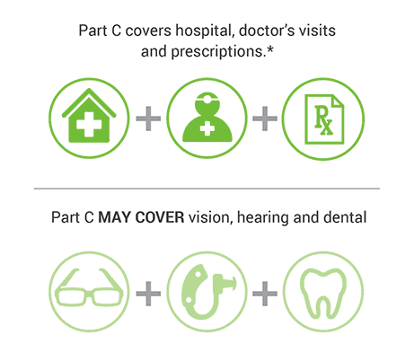
Medicare Part C
Medicare Part C
Also known as Medicare Advantage or Medicare Replacement Plans.
All Part A and Part B benefits are obtained through the private plan.
Cover ALL services that Original Medicare covers, except hospice care. Hospice will be covered by Original Medicare.
May offer extra coverage such as vision, dental and hearing.
Most include prescription drug coverage, Part D.
Medicare pays a fixed amount directly to the plan for the members’ care on a per- member, per-month basis.
Plans must be approved by Medicare annually. Continued coverage in a specific plan type is not guaranteed year to year.
Medicare Advantage Plans are NOT supplemental coverage.

Slide 8
Medicare Part C
Medicare Part C Eligibility
To be eligible to enroll on a Medicare Advantage plan, the beneficiary must:
Be entitled to Medicare Part A
Be enrolled in Medicare Part B
Live in the plan’s service area
If the beneficiary is currently paying an additional premium for Part A and/or Part B, the beneficiary must continue paying this premium even if on a Medicare Advantage plan.

Slide 9
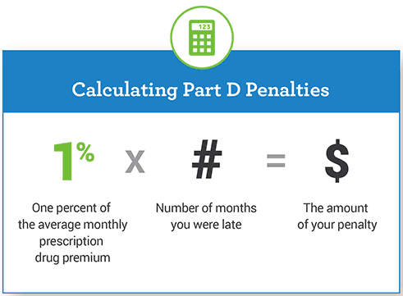
Medicare Part D
Medicare Part D
Part D is prescription drug coverage and is offered to everyone with Medicare.
To get Part D, the beneficiary must join a plan run by an insurance company or other private company approved by Medicare.
Each plan will vary in cost and covered drugs.
Part D plans can change from year to year.
Part D Late Enrollment Penalty (LEP)
There is a late penalty premium for not joining a Medicare Part D drug plan when the beneficiary first becomes eligible for Medicare.
For example: If the average monthly prescription drug premium is $33.19, the penalty fee will be calculated as 1% of $33.19, multiplied by the number of months late enrolling in Part D. If the beneficiary was 12 months late in enrolling, the penalty would be $3.98, paid on top of the drug plan’s monthly premium.

Slide 10
Medicare Part D
Medicare Part D Coverage Gap
Most Medicare Prescription Drug Plans have a coverage gap (also called the “donut hole”).
This is a temporary limit on what the drug plan will cover for drugs. Not everyone will enter the coverage gap.
The coverage gap begins after the beneficiary and plan have spent a certain amount for covered drugs.
Most Part D plans are subject to the gap.
Coverage Begins
(Jan 1)
Covered for the Rest of the Year
(Dec 31)
Initial Coverage:
Plan and member pay their share of the costs until reaching a total drug cost of $4,430
Coverage Gap
“Donut Hole”
Little or no coverage,
members are discounted until they reach $7,050
Coverage Kicks Back In (Catastrophic Coverage)

Slide 11
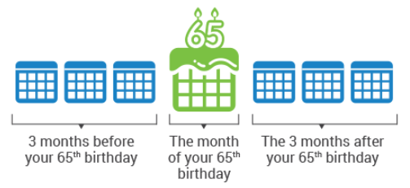
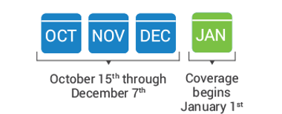
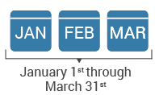
Medicare Enrollment Periods
Initial Enrollment Period (IEP)
Annual Enrollment Period (AEP)
Medicare Advantage
Open Enrollment Period
(MA-OEP)
Medicare beneficiary may add, change or drop their Medicare Advantage or PDP plan.
Anyone with:
Medicare Parts A & B can switch to a Part C plan
Medicare Part C can switch back to Parts A & B
Medicare Part C can switch to a new Part C plan
Anyone who has or is signing up for Medicare Parts A or B can join, drop or switch a Part D prescription drug plan.
Anyone enrolled in a Medicare Advantage (MA) plan on January 1 can change MA plans.
Medicare beneficiaries already enrolled in a Medicare Advantage plan are allowed a one-time election to either:
Switch to a different MA plan
-OR-
Switch from a Medicare Advantage plan to Original Medicare and a standalone Part D plan.
Does not allow switching from original Medicare to a Medicare Advantage plan.
Timeframe when member is initially eligible for Medicare.
During this span of time, a member may join Medicare Parts A, B, C and D.

Slide 12
Medicare Advantage Plans Sales Territory and Plan Type
Health First
Health Plans
Classic, Value, Rewards, Secure
HMO and POS Plans offered in:
AdventHealth
Advantage Plans
Sunsaver
Volusia
Flagler
Seminole
Highlands
Hardee
HMO Plan offered in:
Brevard
Indian River

Slide 13
Medicare Advantage Plans Service Area
It is important to understand the difference between Service Area
and Provider Network.
Service Area
The Service Area defines which counties are eligible for either Health First Health Plans or AdventHealth Advantage Plans plan coverage. For example, a member residing in Brevard County would only be eligible for the Health First Health Plans brand products.
Provider Network
The Provider Network, combines all providers contracted with both Health First Health Plans and AdventHealth into a single network.
Contracted Providers, either via Health First Health Plans or AdventHealth will be accessible to all Medicare members, regardless of Service Area.

Slide 14
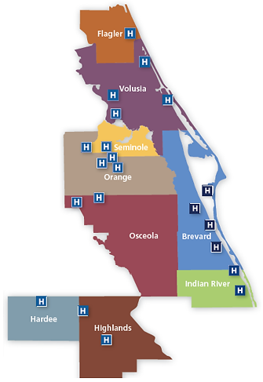
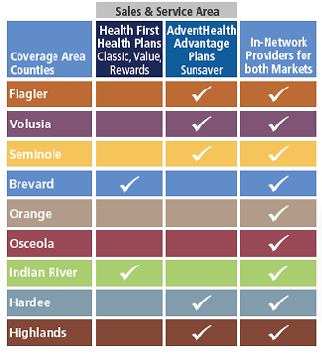
Medicare Service Area

Slide 15
Medicare Products
Health First Health Plans
Classic HMO-POS
Value HMO
Rewards HMO
Secure HMO (no Part D coverage)
AdventHealth Advantage Plans
SunSaver HMO
All our plans include:
Worldwide Coverage for Emergency & Urgent Care
Free Gym Membership
No referrals needed to see a Specialist (the specialist may require one, but the plan does not)

Slide 16
Sales and Enrollment Procedures
Prospective Member (PM) Education Options:
Sales kits (can be mailed upon request)
Home appointments
Websites
https://www.hf.org/health_plans/brokers/medicare.cfm or
https://hf.org/ahap/brokers/medicare.cfm
Medicare (medicare.gov or 1.800.MEDICARE)
Phone – Customer service 1.800.716.7737

Slide 17
Sales and Enrollment Procedures
For compliance, follow these best practices:
Beneficiary initiates contact
Agent completes Scope of Appointment
Agent conducts sales presentation
Medicare Basics, Part D, Enrollment Periods
Benefits at a Glance (BAG)
Summary of Benefits, Formulary, Directory
Answer questions
Complete Enrollment Application
Agent submits enrollment within 24 hours of signed application

Slide 18
Sales and Enrollment Procedures
Scope of Appointment
The Sales representative must clearly identify the types of product(s) that will be discussed, obtain agreement from the beneficiary and document that agreement.
A completed SOA should be submitted to Health First Health Plans or AdventHealth Advantage Plans with each enrollment application.
The Scope of Appointment (SOA) form is located from the public website Brokers page and also from the Medicare Enrollment Portal electronic enrollment platform.

Slide 19
Sales and Enrollment Procedures
During individual appointments, brokers may not:
Promote non-healthcare-related products
Solicit/accept an enrollment request for a January 1 effective date prior to the start of the Annual Election Period on October 15
Discuss plan options that were not agreed to in the Scope of Appointment
Inappropriate and Prohibited Marketing/Sales Activities
Conducting health screenings
Providing cash or monetary rebates
Making unsolicited contact
Use “Absolute Statements” when describing the plans

Slide 20
Sales and Enrollment Procedures
Sales Events
Example of Do’s & Don’ts:
Do provide light snacks and refreshments
Don’t solicit enrollment applications prior to start of the Annual Election Period (AEP)
Don’t require information as a prerequisite for events (contact information)
Educational Events
Example of Do’s & Don’ts:
Do provide light snacks and refreshments
Don’t talk about Medicare plan-specific premiums and/or benefits
Don’t display and/or distribute summary of benefits or provider directory
Don’t conduct or promote sales activities

Slide 21
Sales and Enrollment Procedures
Use the beneficiary Medicare ID card to:
Verify name and spelling
Verify and record the Medicare Beneficiary Identifier
Verify and record Medicare Part A and Part B effective dates
It is not required to submit a copy of the Medicare card.

Slide 22
Sales and Enrollment Procedures
SALES KITS
Always use a complete kit:
Benefits at a Glance (BAG)
Summary of Benefits
Enrollment application
Postage-paid return envelope
Multi-language insert
Provider Directory, Formulary
Privacy Policy
Stars Rating

Slide 23
Sales and Enrollment Procedures
Premium Payment Options
For monthly premium plans or late enrollment penalties (LEPs):
Monthly invoices
Electronic funds transfer (EFT)
Social Security withholding (preferred option)
NOTE:
Brokers may make payments on behalf of their members using the member’s mode of payment.
Brokers may never make payments for their members using the broker’s mode of payment.

Slide 24
Consequences
Potential Consequences of Engaging in Inappropriate or Prohibited Marketing/Sales Activities:
Disciplinary action
Appointment termination
Forfeiture of future compensation
Complaints received by members or prospective members in reference to a Broker with any aspect of the Health Plan’s operations, activities or behavior are addressed via the Complaints Tracking Module (CTM).
Members may contact Health First/AdventHealth Advantage Plans to file a grievance in writing or by telephone.
Health First/AdventHealth Advantage Plans will legally comply with all State Insurance Department investigations.

Slide 25
Sales and Enrollment Procedures
Does Your Enrollee Have Other Insurance?
If you currently have health coverage from an employer or union, joining a plan could:
Affect your employer or union health benefits, including prescription drug coverage
Cause loss of your employer or union coverage
Important: Read the communications your employer or union sends. If you have questions, visit their website or contact the office listed in their communications. If there isn’t any information on whom to contact, your benefits administrator or the office that answers questions about your coverage can help.

Slide 26
What to Expect Next
Within 10 calendar days, a member will receive:
An acknowledgment letter showing their member number, plan name and effective date. This can be used as proof of coverage until he/she receives their ID card.
Within 15 calendar days, a member will receive:
An enrollment verification letter. This letter verifies their enrollment request into our plan.
A member ID card that will be used for all medical and prescription needs in place of the red, white and blue Medicare card.
Within 90 calendar days, a member will receive:
A welcome call from the Member Engagement Department.

Slide 27
What to Expect Next
In 2022, the members’ Evidence of Coverage (EOC), Formulary and Provider/ Pharmacy Directory will NOT be included in the Annual Notice of Change mailing.
Annual Notice of Changes mailings will include the ANOC Postcard, which will contain instructions to order hard copies of the following 2022 plan documents:
2022 Evidence of Coverage
2022 Provider/Pharmacy Directory
2022 Prescription Drug Formulary

Slide 28
What to Expect Next
Members may order an Evidence of Coverage, Provider/Pharmacy Directory and Prescription Drug Formulary in one of three ways:
Order online through our Health First Health Plans or AdventHealth Advantage Plans websites, or
By contacting Customer Service via the phone number listed on the post card, callers will have the option from the phone menu to order their documents. This option will connect the caller to a live representative for assistance, or
In person
Members may order hard copies of their upcoming plan documents beginning October 1

Slide 29
Broker Compensation
Medicare Advantage (MAPD) New
Medicare Advantage (MAPD) Change from other Carrier
2022 Plan Year | Initial Year | Renewal Year
MAPD Plans | $573 | $287 annually, or prorated based on member effective date with Health First
2022 Plan Year | Initial Year | Renewal Year
MAPD Plans | $287 | $287 annually, or prorated based on member effective date with Health First

Slide 30
Sales Office Locations
Office Location | Services Available
Main Office: 6450 U.S. Highway 1 Rockledge, FL 32955 General office hours: Weekdays, 8 a.m. to 5 p.m. | Customer Service All Sales functions
AdventHealth Advantage Plans: 1425 W. Granada Blvd., Suite 4 Ormond Beach, FL 32174 General office hours: Weekdays, 8 a.m. to 5 p.m. | AdventHealth Advantage Plans Medicare Sales only

Slide 31
Thank You!

